Slide 1
EPSRC Research Data Policy Awareness
ECS Seminars
sebastian.palucha@durham.ac.uk
Research Data Manager
21 October 2016
Notes:
https://n2t.durham.ac.uk/ark:/32150/r2g158bh28x

Slide 2
EPSRC requirements challenges
Does it cover all produced data?
My project has started before 1st May 2015 …. Do I need to report on data generated so far?
Which metadata standard should I use?
Should access to data be open?
We collaborate with national/worldwide partners …. Who owns/is responsible for the data?
Where is long-term archival storage for my data?
Is research software considered as data?
What about the cost?
What happens if I fail to comply?

Slide 3
EPSRC Policy Framework on research data
Introduced 1st May 2015
Based on Research Council UK data principles
http://www.rcuk.ac.uk/research/datapolicy/
Motivated
To reinforce the integrity, transparency and robustness of the research findings
To increase data potential value through aggregation
To enable new research questions to be addressed
To support the wider exploitation of data

Slide 4
Data Stories
XRCT Data
Single 3D data volume up to 24h
Several sample scans up 100GB
Subsequent computational intensive data analysis
One NERC fellowship 0.5PB
Notes:
Issues:
What is the best name for the sample
Tooth, Plastic Tooth, PS1, NS1, HPD – Second Scan,
Do we need to collect those samples

Slide 5
EPSRC policy scope
“Research data is defined as recorded factual material commonly retained by and accepted in the scientific community as necessary to validate research findings; …”
http://www.epsrc.ac.uk/about/standards/researchdata/scope/
“It is accepted that there may be cases in which it may not be possible or cost effective to preserve research data… Provided that the ability to validate published research findings is not fundamentally compromised, a deliberate decision to dispose of research data at an appropriate time is acceptable in these cases ”
Clarification VII - http://www.epsrc.ac.uk/files/aboutus/standards/clarificationsofexpectationsresearchdatamanagement/

Slide 6
EPSRC policy key principles
“… research data … should be made freely and openly available with as few restrictions as possible in a timely and responsible manner. ”
“… there are legal, ethical and commercial constraints on release of research data. To ensure that the research process … is not damaged by inappropriate release of data, research organisation policies and practices should ensure that these constraints are considered at all stages in the research process.”
Principles I and II - http://www.epsrc.ac.uk/about/standards/researchdata/principles/
Notes:
What is the risk of inappropriate data release?
As an organisation do we require formalised approval process?
See DU guidance on use of Cloud Services.

Slide 7
EPSRC compliance priorities
Publish data with direct persistent URL (like DOIs)
Publish data underpinning research outputs no later then the date of first online publication of the article
Publish other retained research data 12 months after the date of generation or end of the project
Publish metadata to restricted data with reasons and access conditions
Securely preserve data for a minimum of 10-years
http://www.epsrc.ac.uk/files/aboutus/standards/clarificationsofexpectationsresearchdatamanagement/
Notes:
Expectations II,V,VI,VII

Slide 8
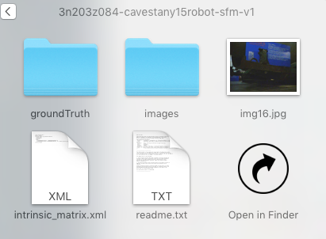
How to publish data with DOI
Take a dataset
2. Describe it
Title
Creators
Year
Description
And others…
3. Assign and publish a DOI
https://doi.org/10.15128/3n203z084
5. Enjoy the benefits
Unique
Persistent
Findable
Track Citation and impact
Data reusability
4. Reuse and reference
[1]T. P. Breckon and P. Cavestany, “Improved 3D Sparse Maps for High-performance Structure from Motion with Low-cost Omnidirectional Robots - Evaluation Dataset.” Durham University, 2016 [Online]. Available: https://doi.org/10.15128/3n203z084
Notes:
http://dx.doi.org/10.5061/dryad.69sg2
The eight core Principles of data citation, http://dx.doi.org/10.7287/peerj.preprints.697v4
Importance
Credit and Attribution
Evidence
Unique Identifiers
Access
Persistence
Specificity and Verifiability
Interoperability and Flexibility

Slide 9
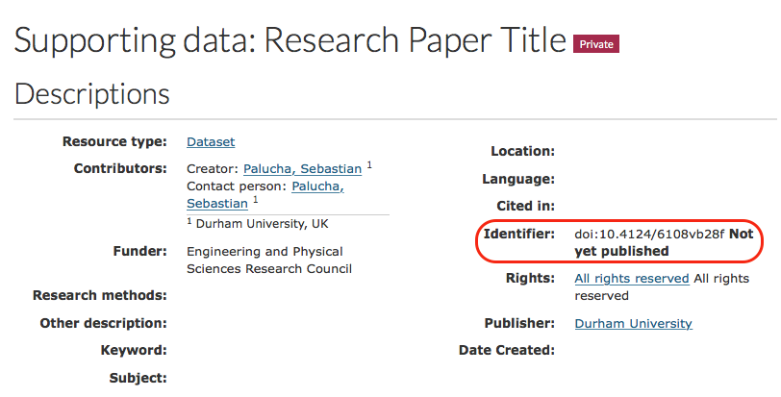
Data publishing via https://collections.durham.ac.uk
Step 1. Upload a dataset and reserve a DOI
Notes:
http://dx.doi.org/10.15128/vt150j378
Add m ore detailed steps? Talk about data preparation?

Slide 10
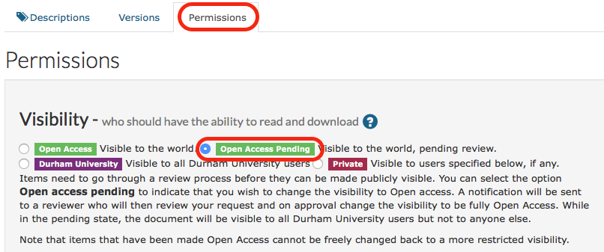
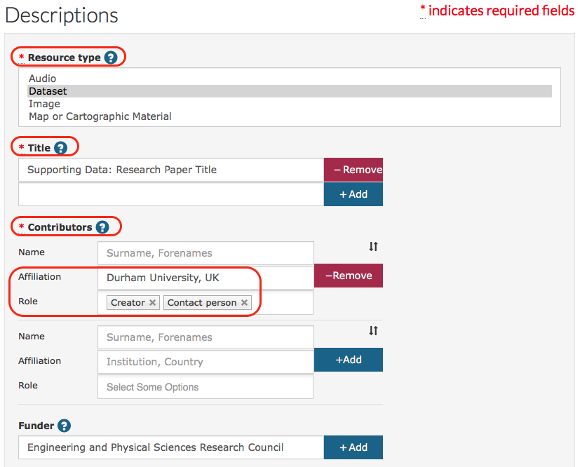
Data publishing via https://collections.durham.ac.uk
Step 2. Add metadata and request “Open Access Pending”
Notes:
http://dx.doi.org/10.15128/vt150j378
Add m ore detailed steps? Talk about data preparation?

Slide 11
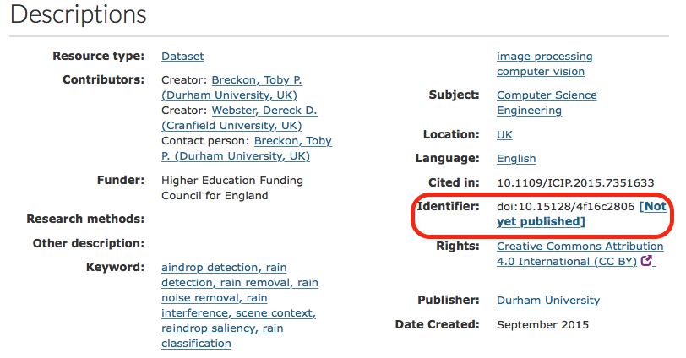
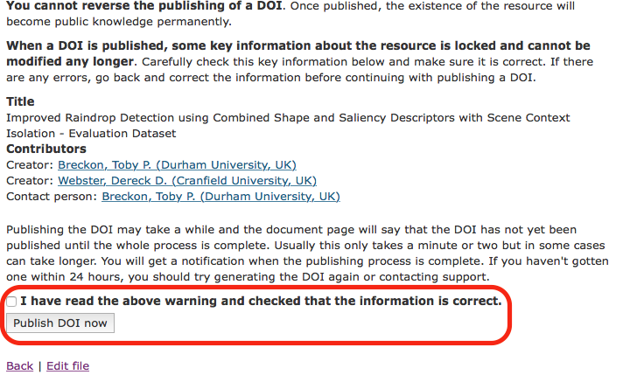
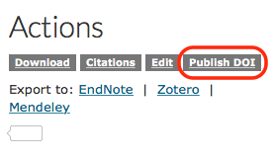
Data publishing via https://collections.durham.ac.uk
Step 3. Publish the DOI
Notes:
http://dx.doi.org/10.15128/vt150j378
Add m ore detailed steps? Talk about data preparation?

Slide 12
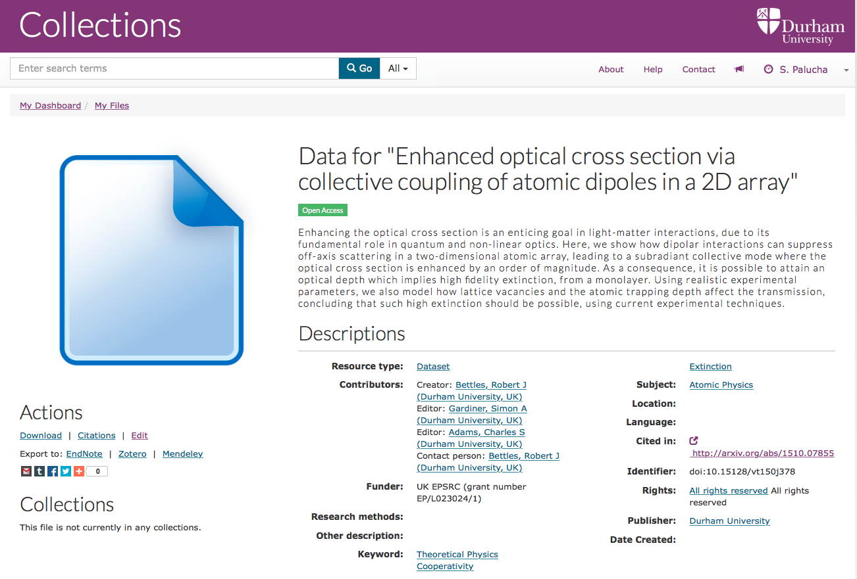
Data publishing via https://collections.durham.ac.uk
Step 4. Link an article with data
Cite the DOI in the article data statement
Add the article DOI at metadata
Notes:
http://dx.doi.org/10.15128/vt150j378
Add m ore detailed steps? Talk about data preparation?

Slide 13
Does research data include software?
Most likely yes
Preserve if:
Required to replicate your work
More cost-effective than generated data
Share if IPR allows
Follow best practices
FORCE11 Software Citation Working Group. (2016) Software Citation Principles. PeerJ Computer Science 2:e86. https://doi.org/10.7717/peerj-cs.86
https://www.software.ac.uk/resources/guides/epsrc-research-data-policy-and-software
https://guides.github.com/activities/citable-code/
Notes:
Importance: Software should be considered a legitimate and citable product of research. Software citations should be accorded the same importance in the scholarly record as citations of other research products, such as publications and data; they should be included in the metadata of the citing work, for example in the reference list of a journal article, and should not be omitted or separated. Software should be cited on the same basis as any other research product such as a paper or a book, that is, authors should cite the appropriate set of software products just as they cite the appropriate set of papers.
Credit and attribution: Software citations should facilitate giving scholarly credit and normative, legal attribution to all contributors to the software, recognizing that a single style or mechanism of attribution may not be applicable to all software.
Unique identification: A software citation should include a method for identification that is machine actionable, globally unique, interoperable, and recognized by at least a community of the corresponding domain experts, and preferably by general public researchers.
Persistence: Unique identifiers and metadata describing the software and its disposition should persist—even beyond the lifespan of the software they describe.
Accessibility: Software citations should facilitate access to the software itself and to its associated metadata, documentation, data, and other materials necessary for both humans and machines to make informed use of the referenced software.
Specificity: Software citations should facilitate identification of, and access to, the specific version of software that was used. Software identification should be as specific as necessary, such as using version numbers, revision numbers, or variants such as platforms.

Slide 14
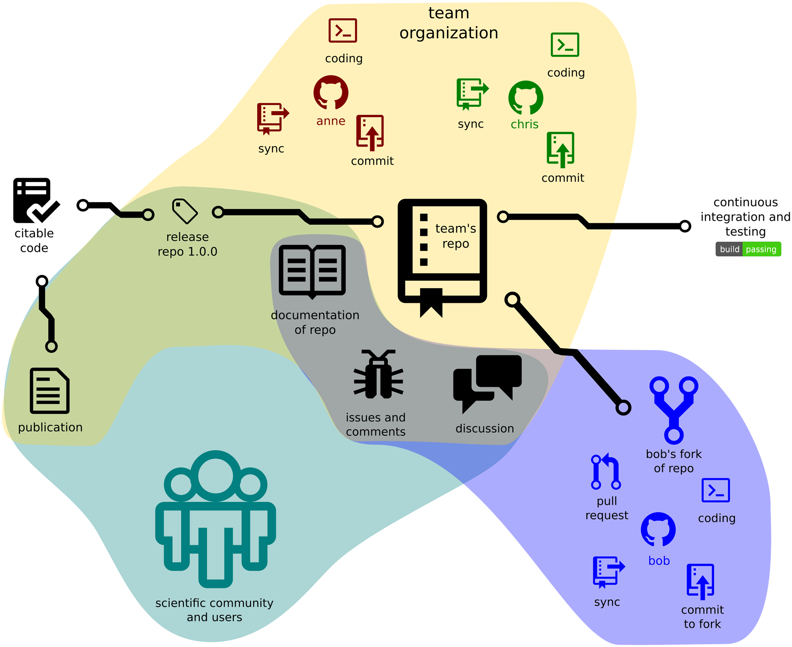
Ten Simple Rules for Taking Advantage of Git and GitHub
Published: July 14, 2016
http://dx.doi.org/10.1371/journal.pcbi.1004947

Slide 15
DU activities
Extension of current data hosting solution
Two new data center build
Delays with hosting solution
Expected: Early 2017
Initial capacity 2/4PB
New services
https://zendto.dur.ac.uk
Preparation GitHub Enterprise for Academics
Notes:
Cost of electricity 50k per 1PB per year
The Core project will also deliver a physical hosting environment, providing the foundations for a resilient, disaster-proof hosting solution. This will include •Primary Data Centre •Secondary Data Centre •Physical connectivity •Power •Cooling •Physical security •Fire protection.

Slide 16
Issues
Best practices in your communities
none digital data
New University IPR Policy developed
Data licensing and ownership
Long term sustainability
Cost per archival storage
EPSRC policy include PhD students
RCUK Concordat on Open Research Data
http://www.rcuk.ac.uk/media/news/160728/
Notes:
Direct or indirect costs associated with data management must be stated in the grant proposal, however,
No expenditure double funded
Only within the duration of the project

Slide 17
Summary or What does EPSRC want you to do with your data
All publication (after 1st may 2015) include data access statement (or explained restrictions)
Data stored for 10 years from the last request
Making data freely and openly available
Cited with DOI
Accompanied with rich metadata (why, what, how)
Exemptions: personal sensitive data, embargo for IPR and commercially sensitive data, not possible cost-effective

Slide 18
http://govote.at/34d1a2
Your research data storage requirements
Your current research data storage practices
Notes:
Pool results https://www.mentimeter.com/s/7971144d7fcfa8eea66e704bd0c7d345/2d1666dcf86e

