Slide 1

Research Data Management Awareness
Leading Research Programme
sebastian.palucha@durham.ac.uk
Research Data Manager
@paluchas
15 February 2017
Download Slides at http://bit.ly/durdm17-2
Notes:
https://www.dropbox.com/s/ccrqd28oicmhp6e/rdm%2Bawarnes%2BLRTraining-2017.pptx?dl=0

Slide 2
Session Outline
I. RDM Overview
  What is “Research Data”?
  What is “Research Data Management” ?
  Why Research Data Management is important?
II. Data Sharing
  How to publish data with DOI?
  IPRs
  DPA and Information Security
III. Data Management Plans
  Example plans
IV. Discussion

Slide 3
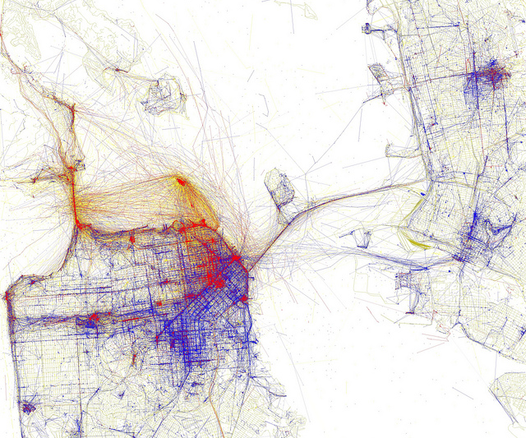
I. RDM Overview
http://govote.at/fd6c85
Eric Fischer @flickr CC-by-sa
Notes:
https://www.flickr.com/photos/24431382@N03/4671562937
CC by sa Eric Fischer
Locals and Tourists San Francisco
Blue pictures are by locals. Red pictures are by tourists. Yellow pictures might be by either.
Base map © OpenStreetMap, CC-BY-SA

Slide 4
Research Data
“...factual material commonly retained by and accepted in the scientific community as necessary to validate research findings...”
EPSRC policy framework on research data - scope:
https://www.epsrc.ac.uk/about/standards/researchdata/scope/
Notes:
There is no single definition, so lets agree some basics...
Situational – eg cctv footage (crime prevention, measure of footfall, demographic data) / ships logs (historical record of events, record of weather patterns, personnel lists) / photographs (historical record of objects or locations, a source of data on techniques or chemical processes of photo development)
Data are core element of scientific research thus data lifecycle can’t be considered independently from research lifecycle.

Slide 5
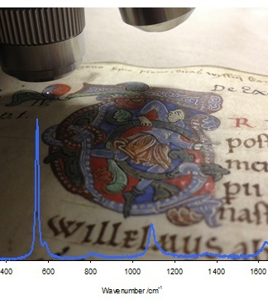
Example data
Raman spectroscopy used to study the inks and pigments of medieval manuscripts. The example shown is from Libellus de Exordio written by by Symeon of Durham ca. 1105.
Lapis lazuli pigment came form Afghanistan
Image courtesy of A. Beeby
Notes:
https://www.dur.ac.uk/library/asc/projects/
https://www.dur.ac.uk/research/directory/staff/?mode=staff&id=171
The example shown is from Libellus de Exordio atque Procursu istius, hoc est Dunelmensis, Ecclesie (The Little Book on the Origins and Progress of this Church, that is of Durham) written by Symeon ca. 1105, and resides normally at Durham, University Library, Cosin V.II.6. The spectrum below show the presence of lapis lazuli which came from what is now Afghanistan.
Talk about data complexities all three direction: size, variety and velocity of data production.

Slide 6
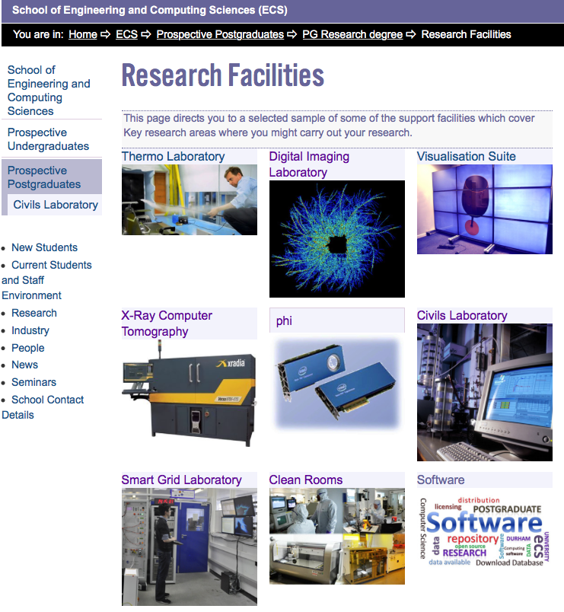
Data Stories
XRCT Data
  Single 3D data volume up to 24h
  Several sample scans up 100GB
  Subsequent computational intensive data analysis
  One NERC fellowship 0.5PB
Notes:
Issues:
What is the best name for the sample
Tooth, Plastic Tooth, PS1, NS1, HPD – Second Scan,
Do we need to collect those samples

Slide 7
What is Research Data Management?
New strategic approach to opening research findings driven by a key principle:
“Publicly-funded research data are a public good, produced in the public interest, ... openly available with as few restriction as possible in timely and responsible manner”
Principle 1 of 7 RCUK Data Principles http://www.rcuk.ac.uk/documents/documents/rcukcommonprinciplesondatapolicy-pdf/
Notes:
Publicly funded research data are a public good, produced in the public interest, which should be made openly available with as few restrictions as possible in a timely and responsible manner.
Institutional and project specific data management policies and plans should be in accordance with relevant standards and community best practice. Data with acknowledged long-term value should be preserved and remain accessible and usable for future research.
To enable research data to be discoverable and effectively re-used by others, sufficient metadata should be recorded and made openly available to enable other researchers to understand the research and re-use potential of the data. Published results should always include information on how to access the supporting data.
RCUK recognises that there are legal, ethical and commercial constraints on release of research data. To ensure that the research process is not damaged by inappropriate release of data, research organisation policies and practices should ensure that these are considered at all stages in the research process.
To ensure that research teams get appropriate recognition for the effort involved in collecting and analysing data, those who undertake Research Council funded work may be entitled to a limited period of privileged use of the data they have collected to enable them to publish the results of their research. The length of this period varies by research discipline and, where appropriate, is discussed further in the published policies of individual Research Councils.
In order to recognise the intellectual contributions of researchers who generate, preserve and share key research datasets, all users of research data should acknowledge the sources of their data and abide by the terms and conditions under which they are accessed.
It is appropriate to use public funds to support the management and sharing of publicly-funded research data. To maximise the research benefit which can be gained from limited budgets, the mechanisms for these activities should be both efficient and cost-effective in the use of public funds.

Slide 8
RCUK Common Principles on Data Policy
Public good: Publicly funded research data are produced in the public interest should be made openly available with few restrictions
Planning for preservation: Institutional and project specific data management policies and plans needed to ensure valued data remains usable
Discovery: Metadata should be available and discoverable; Published results should indicate how to access supporting data
Confidentiality: Research organisation policies and practices to ensure legal, ethical and commercial constraints assessed; research process not damaged by inappropriate release
First use: Provision for a period of exclusive use, to enable research teams to publish results
Recognition: Data users should acknowledge data sources and terms & conditions of access
Public funding: Investment is appropriate and must be efficient and cost-effective.
CC by – Summary prepared by DCC
http://www.rcuk.ac.uk/research/datapolicy/
Notes:
Full text at: http://www.rcuk.ac.uk/research/datapolicy/

Slide 9
What is Research Data Management?
“ Research data management concerns the organisation of data, from its entry to the research cycle through to the dissemination and archiving of valuable results.”
Whyte, A., Tedds, J. (2011). ‘Making the Case for Research Data Management’. DCC Briefing Papers.
http://www.dcc.ac.uk/resources/briefing-papers/making-case-rdm

Slide 10
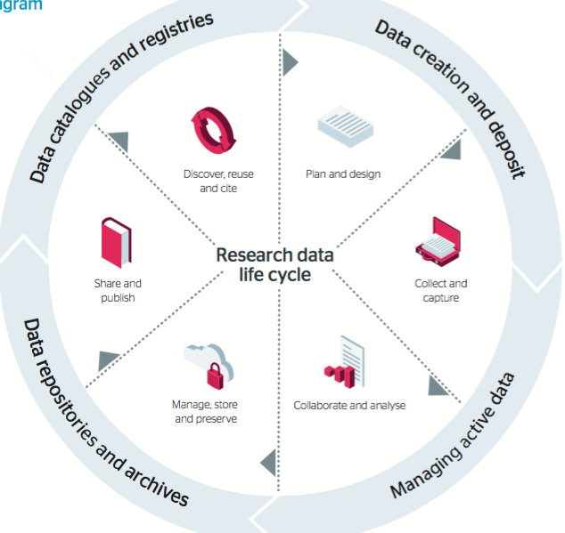
RDM cycle
A dataset life span is longer that the project that generated it
CC by DCC

Slide 11



Funders Requirements
  Researchers are entitled to limited period of privileged use to exploit produced data before sharing
  Data expected to retain for (+)10 years
  Special measures apply where data arise form personal identifiable data
  It is acceptable to use public funds to support RDM
Notes:
You also have requirements or moves to recognise the need to manage and share data from other organisations.
Mention also that journals (eg in biosciences) may require you to submit data alongside a published article as standard practice.
Consensus between Councils:
Data scrutiny assures research integrity
New opportunities by sharing data for inter-disciplinary research, potential for new impact
3. Pragmatic on costs for data curation, clear retention policies, what accessible
Mention that DU Data Policy is under review.

Slide 12

AHRC Access to Data
Requires a technical plan
GC23 Annex – deposit of resources or datasets at the earliest opportunity
  “… any significant electronic resources or datasets created … available in an accessible and appropriate depository for at least three years after the end of their grant …”
http://www.ahrc.ac.uk/funding/research/researchfundingguide/attachments/technicalplan/
http://www.ahrc.ac.uk/funding/research/researchfundingguide/annexes/gc23acknowledgementofsupport/
Notes:
AHRC do not have their own data policy. Instead share the RCUK common principles on data sharing http://www.rcuk.ac.uk/research/datapolicy/.

Slide 13
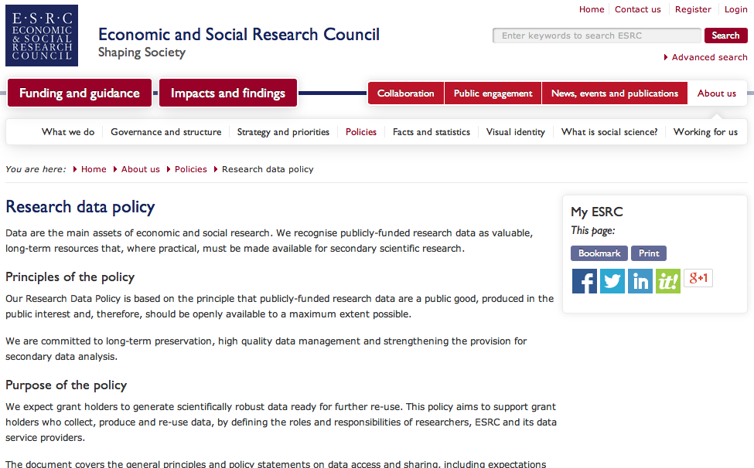
ESRC Data Policy
Requires a data management and sharing plan
Data deposited within 3 moths of the grand ending
12 months embargo to publish data
Data deposited to UK Data Service or other responsible repository
http://www.esrc.ac.uk/about-esrc/information/data-policy.aspx
Notes:
The data must be made available for re-use or archiving with the ESRC data service providers within three months of the end of the grant.

Slide 14

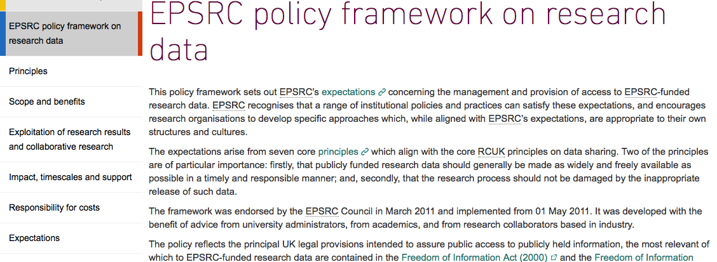
Data Policy
9 expectations required since 1st May 2015
All publications need a statement (with citable DOI) describing how to access the underling data; random compliance checks
  Is there a statement?
  Is data accessible?
12 months to publish
data description
+10 years retention time
Digital and non-digital data
http://www.epsrc.ac.uk/about/standards/researchdata/
Notes:
This one is different, unlike others, no plan requirements
Some detailed clarification are provided here
http://www.epsrc.ac.uk/files/aboutus/standards/clarificationsofexpectationsresearchdatamanagement/

Slide 15
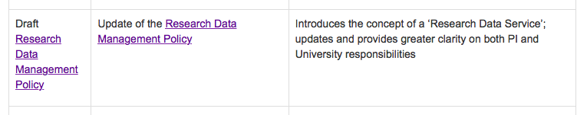
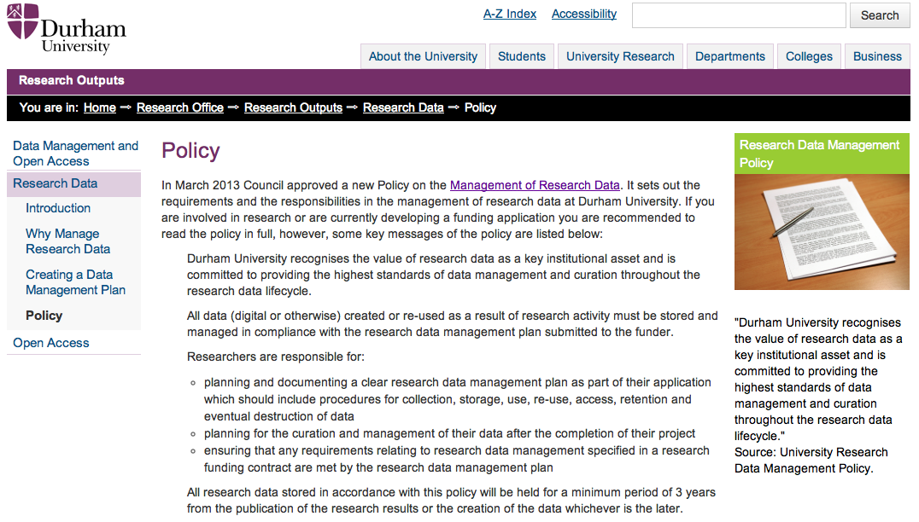
Durham RDM Policy
Currently Under Review. Comments can be send by 17/02/2017
https://www.dur.ac.uk/research.office/local/research.governance/policy/
Notes:
Data retention 3 years after publication to 10 years since last request
The Research Data Management Steering Committee on behalf of UEC is responsible for ensuring the provision of:
- training, support and advice for the management of research data
- services and procedures enabling the registration, deposit, storage, and curation of research data
Researchers are responsible for
- planning and documenting a clear research data management plan as part of their application which should include procedures for collection, storage, use, re-use, access, retention and eventual destruction of data
- planning for the curation and management of their data after the completion of their project
- ensuring that any requirements relating to research data management specified in a research funding contract are met by the research data management plan
- ensuring that a copy of the data management plan is registered with the University’s Research Administration System (RAS)

Slide 16
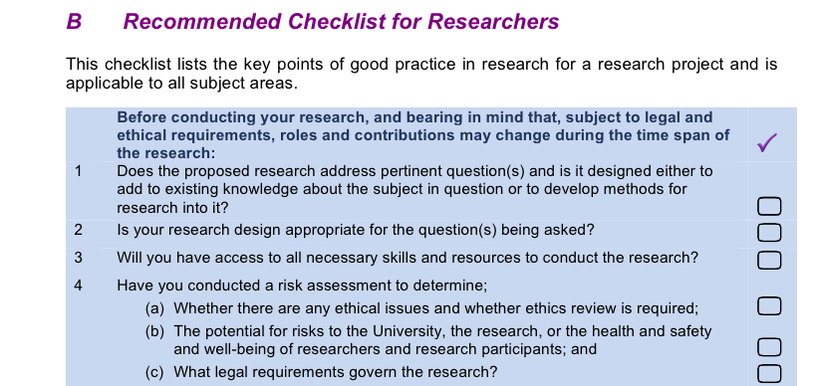
Research Integrity
Policy and Code of Practice
https://www.dur.ac.uk/hr/policies/research/
Notes:
Collection and retention of data - Department
Heads of Departments should ensure compliance with all legal, ethical, funding body and organisational requirements for the collection, use and storage of data, especially personal data and sensitive personal data, where particular attention should be paid to the requirements of data protection legislation. They should also maintain confidentiality where undertakings have been made to third parties or to protect intellectual property rights. They should ensure that research data relating to publications is available for discussion with other researchers, subject to any existing agreements on confidentiality.
Data should be kept intact for any legally specified period and otherwise for three years at least, subject to any legal, ethical or other requirements, from the end of the project. It should be kept in a form that would enable retrieval by a third party, subject to limitations imposed by legislation and general principles of confidentiality.
Heads of Departments should ensure researchers within their department comply with any subject-specific requirements for the retention of data; for example, certain disciplines, such as health and biomedicine, may require research data to be retained for a considerably longer period.
If research data is to be deleted or destroyed, either because its agreed period of retention has expired or for legal or ethical reasons, it should be done so in accordance with all legal, ethical, research funder and organisational requirements and with particular concern for confidentiality and security.
Heads of Departments should put in place procedures, resources (including physical space) and administrative support to assist researchers in the accurate and efficient collection of data and its storage in a secure and accessible form.
Collection and retention of data - Researchers
Researchers wishing to use personal data must register with the University's Data Protection Officer.
Researchers should comply with all legal, ethical, funding body and organisational requirements for the collection, use and storage of data, especially personal data, where particular attention should be paid to the requirements of data protection legislation. They should also maintain confidentiality where undertakings have been made to third parties or to protect intellectual property rights. Guidance is available from the University’s Data Protection Officer.
Organisations and researchers should ensure that research data relating to publications is available for discussion with other researchers, subject to any existing agreements on confidentiality.
Data generated in the course of research should be kept securely in paper or electronic format, as appropriate and in compliance with legislation etc. It should be kept where possible under the control of the University in a form that would enable retrieval by a third party, subject to limitations imposed by legislation and general principles of confidentiality. Back up records should always be kept for data stored on a computer
Data should be kept intact for any legally specified period and otherwise for 3 years at least, subject to any legal, ethical or other requirements, from the end of the project.
Researchers should comply with any specific requirements by the grant funding body for the retention of data; for example, certain disciplines, such as health and biomedicine, may require research data to be retained for a considerably longer period. For example, the Wellcome Trust considers a minimum of 10 years after the completion of a research project to be an appropriate period.
If research data is to be deleted or destroyed, either because its agreed period of retention has expired or for legal or ethical reasons, it should be done so in accordance with all legal, ethical, research funder and organisational requirements and with particular concern for confidentiality and security.
Researchers should consider how data will be gathered, analysed and managed, and how and in what form relevant data will eventually be made available to others, at an early stage of the design of the project.
Researchers should collect data accurately, efficiently and according to the agreed design of the research project, and ensure that it is stored in a secure and accessible form.

Slide 17






… it is a requirement
Notes:
You also have requirements or moves to recognise the need to manage and share data from other organisations.
Mention also that journals (eg in biosciences) may require you to submit data alongside a published article as standard practice.
PNAS – Proceedings of the National Academy of Science
http://www.pnas.org/site/authors/journal.xhtml
The Royal Society
http://royalsocietypublishing.org/data-sharing
Plose One from 1/02/2014
Authors must provide a Data Availability Statement describing compliance with PLOS’s policy, which will be published with paper.
Two key things to summarize about the policy are:
The policy does not aim to say anything new about what data types, forms and amounts should be shared.
The policy does aim to make transparent where the data can be found, and says that it shouldn’t be just on the authors’ own hard drive.

Slide 18
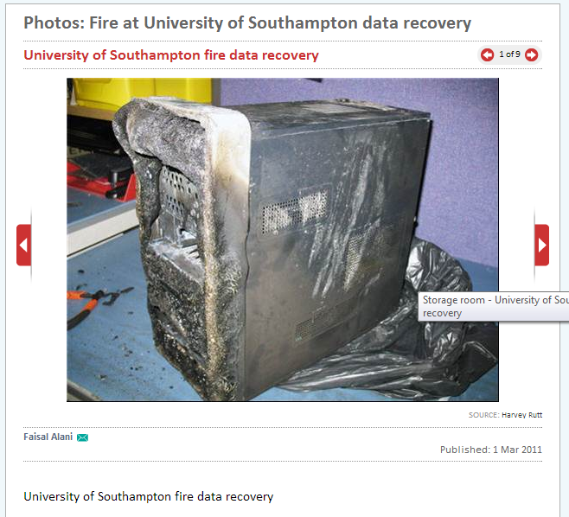
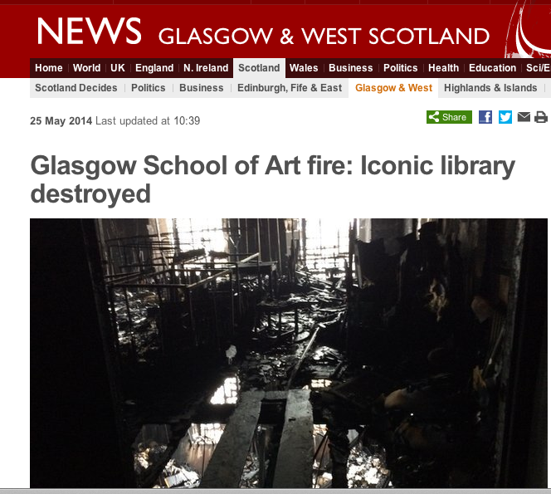
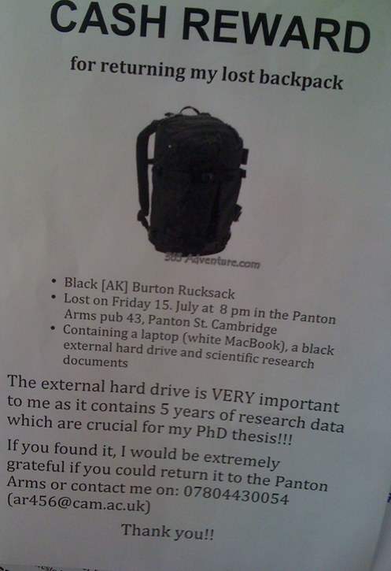

… it is good practice
Notes:
What would happened if you lost external hard drive with few years of research data for your PhD?
Image from Peter Murray-Rust blog CC-by - http://blogs.ch.cam.ac.uk/pmr/2011/08/01/why-you-need-a-data-management-plan/
http://www.bbc.co.uk/news/uk-scotland-glasgow-west-27556659
http://home.web.cern.ch/topics/birth-web 30 April 1993

Slide 19
… boosts your profile
“… 10,555 studies … we found that studies that
made data available in a public repository
received 9% more citations than
similar studies for which the data was not made available …”
Piowar H. & Vision T. (2013)
“Data reuse and the open data citation advantage”
PeerJ, http://peerj.com/articles/175/
Notes:
Also “… The citation benefit varied with date of dataset deposition: a citation benefit was most clear for papers published in 2004 and 2005, at about 30%.”
However, not normative, the citations for data is an essential component of data publication, sharing and reuse.

Slide 20
… data can be re-used
“The best thing to do with your data will be thought of by someone else”
Rufus Pollock, co-founder Open Knowledge Foundation
Impact and innovation
Sharing of Data Leads to Progress on Alzheimer’s
Collaboration and teaching
Iris Flower Data Set, Fisher, R.A. 1936
1000 Genomes – A Deep Catalogue of Human genetic Variation
Notes:
You might be thinking, I don’t want people to find out if I have made a mistake….
Well, you may, and then you can own up and move on. But what you should be more worried about is being able to identify if others have made a mistake and how that might impact on your research.
http://www.economist.com/blogs/freeexchange/2013/04/debt-and-growth
@rufuspollock Rufus Pollock,
1000 Genomes - is a community resource project that aims to release data rapidly for the benefit of the scientific community. Use of project data for:
Global and large-scale analyses
Methods development
Disease studies
Population comparisons
Iris Flower – from Machine Learning repository

Slide 21
What you are expected to do?
Plan and document new data (metadata)
Budget for RDM in their grant application (staff, storage)
For every new publication - share all sharable data (exemptions: IPR, sensitive data) and add an access statement
Archive data +10 years
Be aware of available help

Slide 22
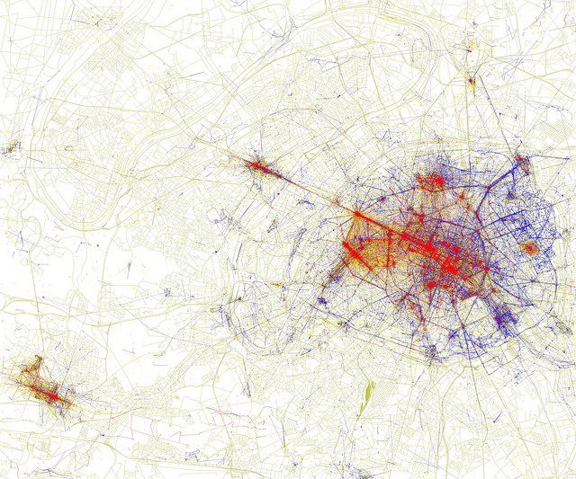
II. Data Sharing
http://govote.at/fd6c85
Eric Fischer @flickr CC-by-sa
Notes:
https://www.flickr.com/photos/walkingsf/4671584999/in/photostream/
Eric Fischer
Follow
Locals and Tourists #4 (GTWA #3): Paris
Blue pictures are by locals. Red pictures are by tourists. Yellow pictures might be by either.
Base map © OpenStreetMap, CC-BY-SA

Slide 23
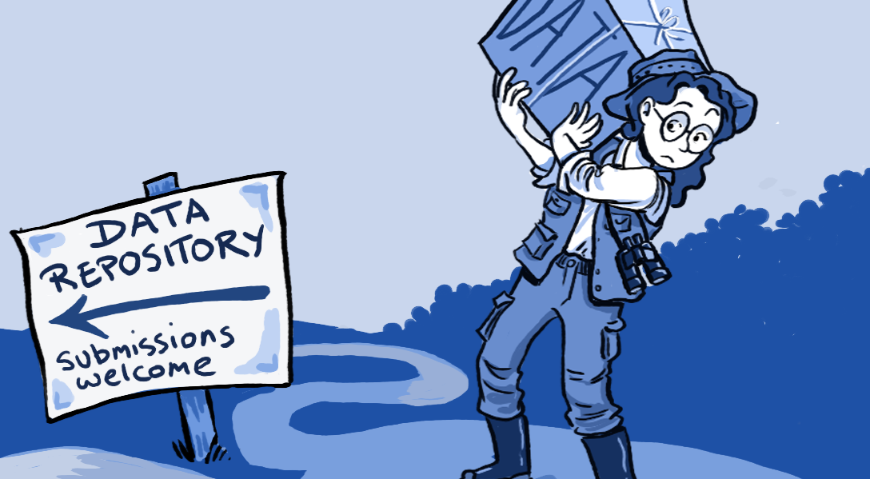




Sharing your data
Cite as: ATLAS Collaboration ( 2013 ) HepData, http://doi.org/10.7484/INSPIREHEP.DATA.A78C.HK44
Notes:
Roche DG, Lanfear R, Binning SA, Haff TM, Schwanz LE, et al. (2014) - Roche DG, Lanfear R, Binning SA, Haff TM, Schwanz LE, et al. (2014) Troubleshooting Public Data Archiving: Suggestions to Increase Participation. PLoS Biol 12(1): e1001779. doi:10.1371/journal.pbio.1001779
Mention various purpose data repositories: founders, subject based or general purpose. In common their all provide means to cite data, see example from inSPIRE.
10-15 mins from end?
Time to have a look, or ask Sebastian questions?
Dryad: Data underpinning medical and science publications, traditionally strong in health and biomedical sciences. Primarily peer-reviewed, but also some non-peer reviewed such as dissertations and theses. Spreadsheets, photos, software code, video... Up to 10GB per publication.
Sample search: Protein
Figshare: Not just data (but remember data is ‘situational’. Multidisciplinary. Majority usage amongst PhD students and postdocs. A lot of presentations, posters and diagrams, but also datasets, code and publications.
Sample browse: Chemistry
Welcome to INSPIRE, the High Energy Physics information system
Search for “Data from Figure 7 from: Measurements of Higgs boson production and couplings in diboson final states with the ATLAS detector at the LHC”

Slide 24
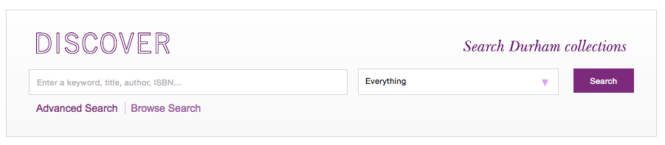
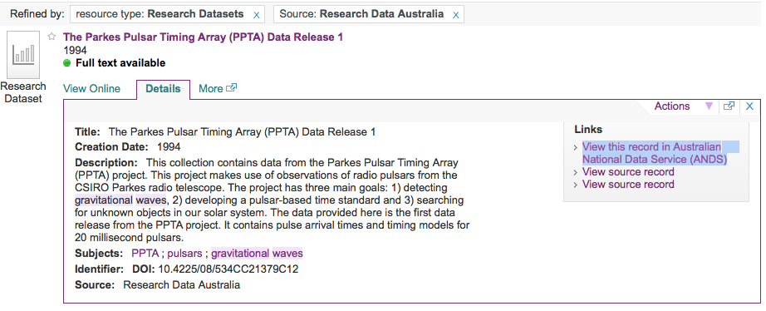
Discover Durham Collections
http://discover.durham.ac.uk

Slide 25

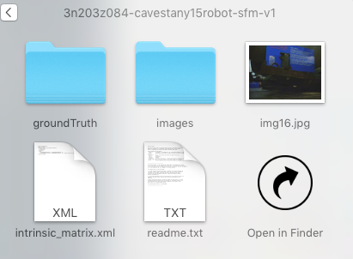

How to publish data with DOI
Take a dataset
2. Describe it
Title
Creators
Year
Description
And others…
3. Assign and publish a DOI
https://doi.org/10.15128/3n203z084
5. Enjoy the benefits
Unique
Persistent
Findable
Track Citation and impact
Data reusability
4. Reuse and reference
[1]T. P. Breckon and P. Cavestany, “Improved 3D Sparse Maps for High-performance Structure from Motion with Low-cost Omnidirectional Robots - Evaluation Dataset.” Durham University, 2016 [Online]. Available: https://doi.org/10.15128/3n203z084
Notes:
http://dx.doi.org/10.5061/dryad.69sg2
The eight core Principles of data citation, http://dx.doi.org/10.7287/peerj.preprints.697v4
Importance
Credit and Attribution
Evidence
Unique Identifiers
Access
Persistence
Specificity and Verifiability
Interoperability and Flexibility

Slide 26
Prepare a dataset
*.zip datasets
readme.txt
Avoid proprietary binary formats
Tables and worksheet as separate files
File names reflecting the content
Include detailed description in readme.txt
Dataset title
Reference to a paper
Full information about contributors
Grant title
Explain folder structure
Explain data creation flow
Links with the paper graphs and conclusions
Information on software used or source code

Slide 27
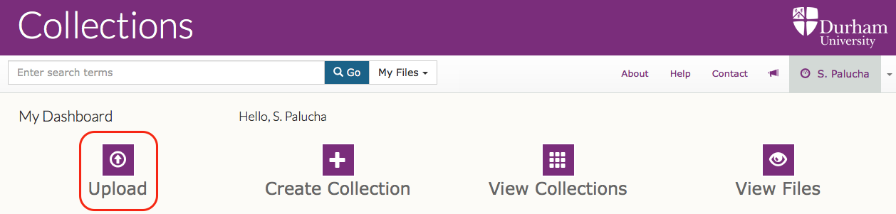
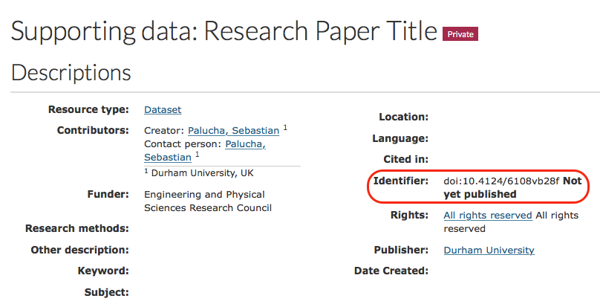
Data publishing via https://collections.durham.ac.uk
  Step 1. Upload a dataset and reserve a DOI
Notes:
http://dx.doi.org/10.15128/vt150j378
Add m ore detailed steps? Talk about data preparation?

Slide 28
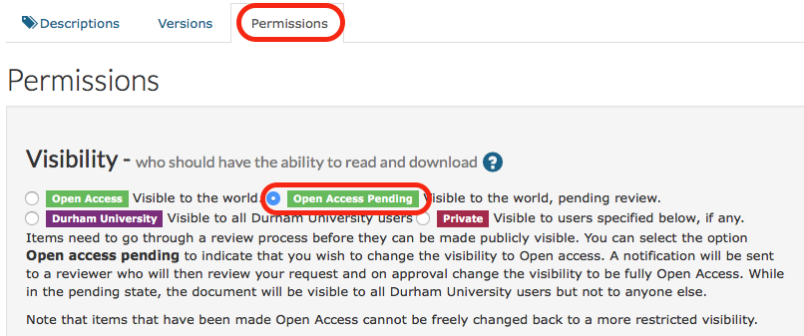
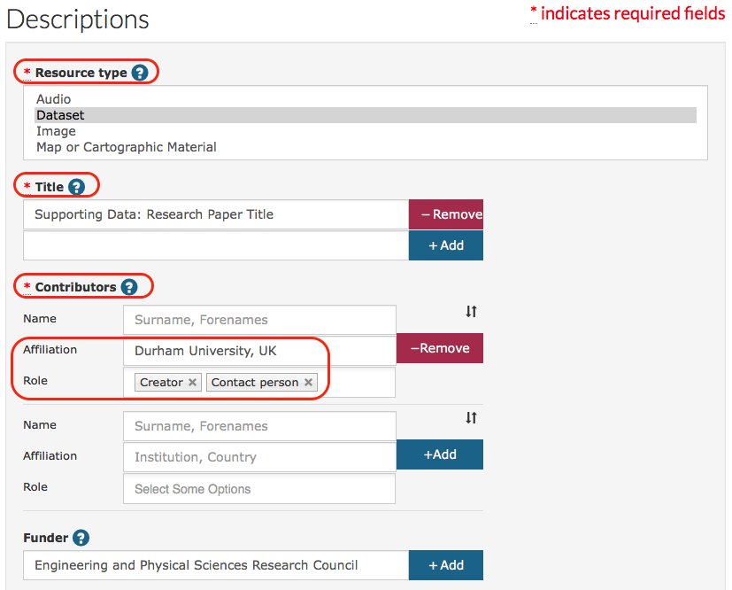
Data publishing via https://collections.durham.ac.uk
  Step 2. Add metadata and request “Open Access Pending”
Notes:
http://dx.doi.org/10.15128/vt150j378
Add m ore detailed steps? Talk about data preparation?

Slide 29
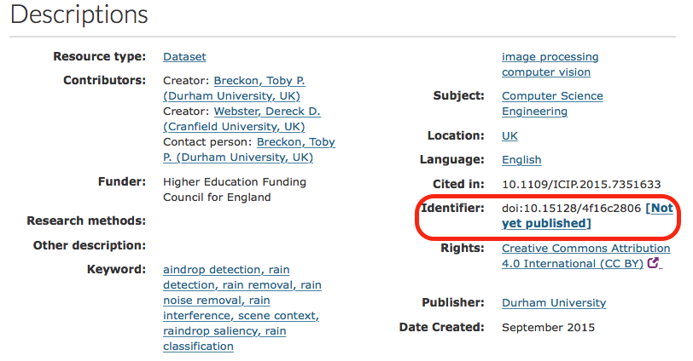
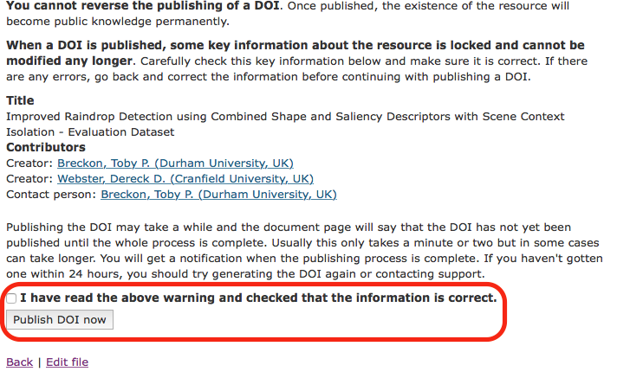
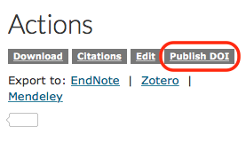
Data publishing via https://collections.durham.ac.uk
  Step 3. Publish the DOI
Notes:
http://dx.doi.org/10.15128/vt150j378
Add m ore detailed steps? Talk about data preparation?

Slide 30
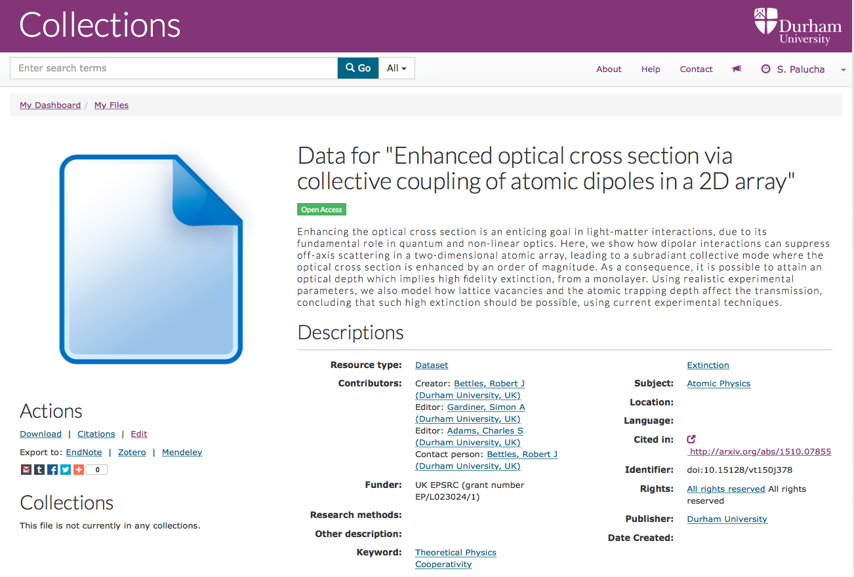
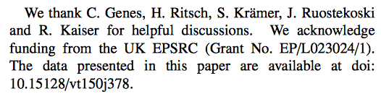
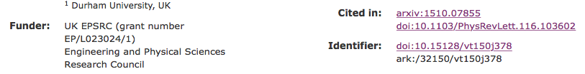
Data publishing via https://collections.durham.ac.uk
  Step 4. Link an article with data
  Cite the DOI in the article data statement
  Add the article DOI at metadata
Notes:
http://dx.doi.org/10.15128/vt150j378
Add more detailed steps? Talk about data preparation?

Slide 31
Sharing your data
Who owns the copyright in the data?
  The University owns copyright by default
      Can be subject to funders requirements
      Background IPRs
  3rd party copyright
      - Database software
  Data licensing
    Open Data Commons http://opendatacommons.org
    Creative Commons https://creativecommons.org
    Open Government Licencehttp://data.gov.uk/blog/new-open-government-license
Notes:
Be aware on copyright constraints. Applying commons license will not take your IPR, people will gain right to freely use and distribute but they must properly attribute you work.
Ownership of data interesting post at Open Knowledge Foundation list 14/05/2014 abut UK/EU interpretation
Research software as open source - some interesting legal aspects are discussed in the International Free and Open Source Law Book in the UK section.

Slide 32


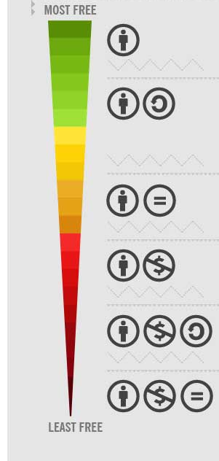
License your data for reuse
Creative Commons CC 0
(public domain)
Creative Commons CC BY
Creative Commons Attributes (Limitation)
  SA Share Alike
  Reduce interoperability
  ND None Derivatives
  Restricts use
  NC Non-Commercial
  What counts as commercial?

Slide 33
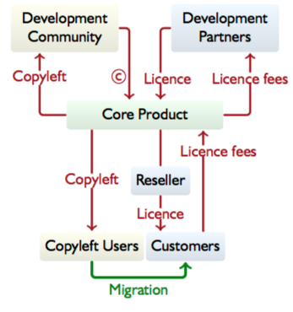
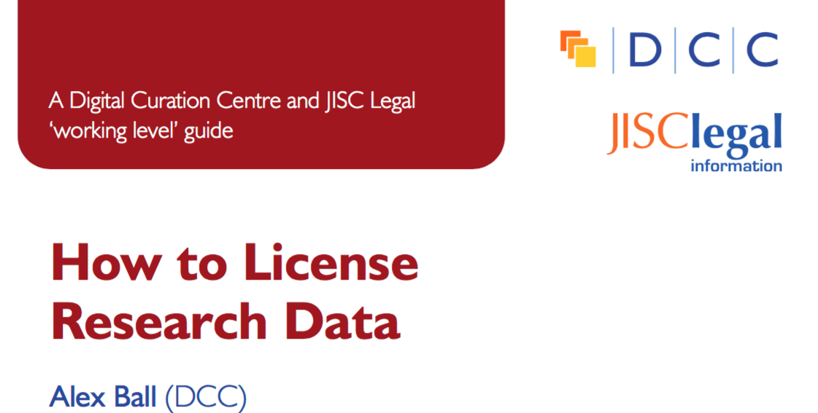
Dual Licensing
CC by Alex Ball (DCC)
http://www.dcc.ac.uk/resources/how-guides/license-research-data
Notes:
Ball, A. (2014). ‘How to License Research Data’. DCC How-to Guides. Edinburgh: Digital Curation Centre. Available online: http://www.dcc.ac.uk/resources/how-guides

Slide 34
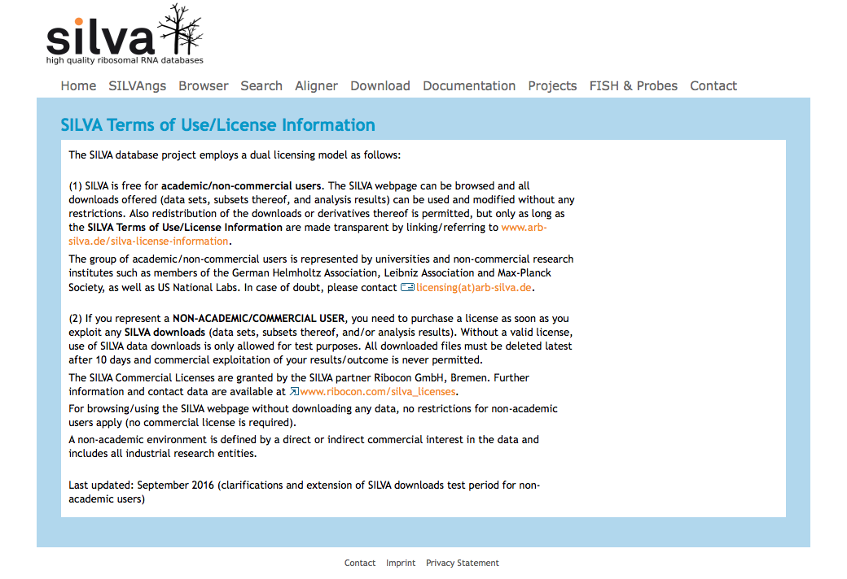
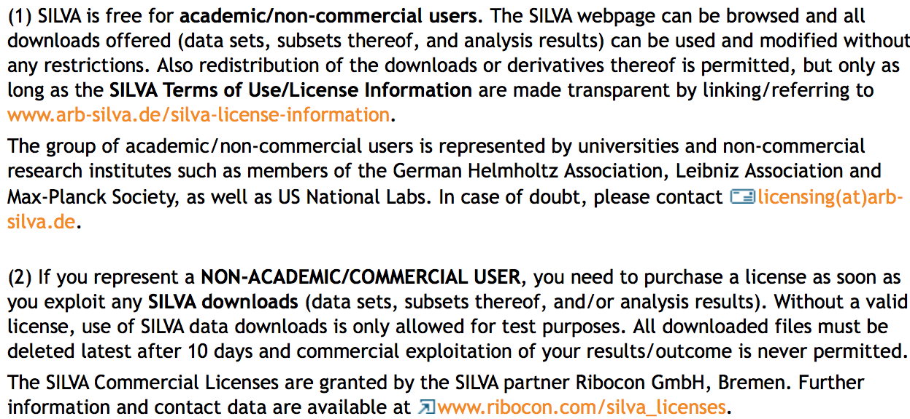
Dual Licensing Example
Silva high quality ribosomal RNA databases
https://www.arb-silva.de/silva-license-information
Notes:
Ball, A. (2014). ‘How to License Research Data’. DCC How-to Guides. Edinburgh: Digital Curation Centre. Available online: http://www.dcc.ac.uk/resources/how-guides

Slide 35
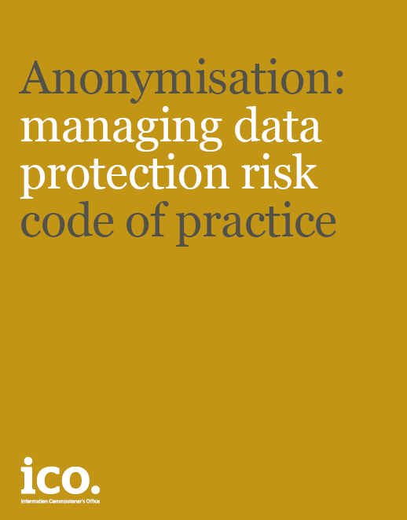
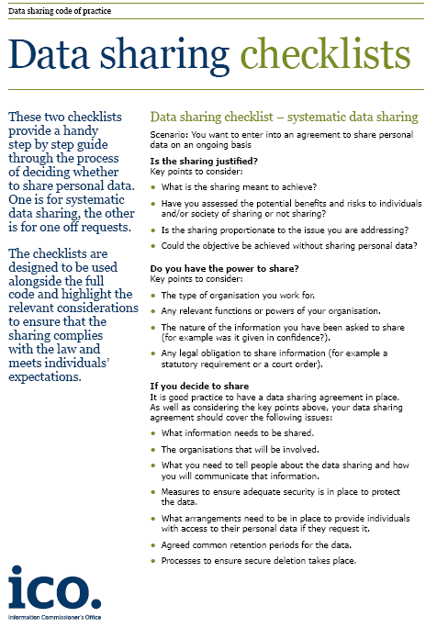
How to share data responsibly
Information Commissioner’s Office published guides on data security and sharing:
Is the sharing justified?
  Benefits and risks
Do you have power to share?
  Participant Consents
Is sharing conditional?
  How we will protect data
http://ico.org.uk/for_organisations/data_protection/topic_guides/data_sharing
http://ico.org.uk/for_organisations/data_protection/topic_guides/anonymisation
Notes:
Personal and Sensitive Data

Slide 36
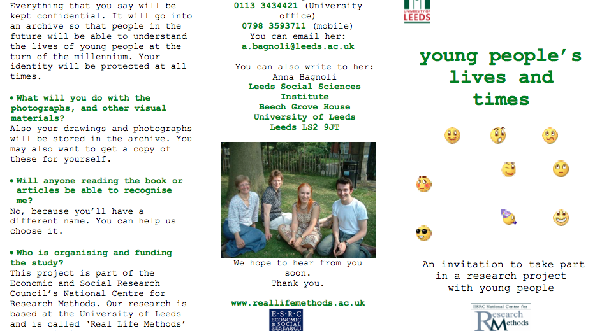
Informed Consent
http://www.data-archive.ac.uk/create-manage/consent-ethics/consent?index=3
CC by sa www.reallifemethods.ac.uk
Notes:
Written consent includes and information sheet and a consent form signed by the participant.
Part of the ESRC project to developed new research methods in real life - http://www.reallifemethods.ac.uk
Example consents forms http://www.data-archive.ac.uk/create-manage/consent-ethics/consent?index=3 interviews, children participation.
An information sheet should cover topics such as:
Purpose of the research
Benefits and risk
Terms for withdrawal
Usage of data during project and after
Ethical use of data

Slide 37
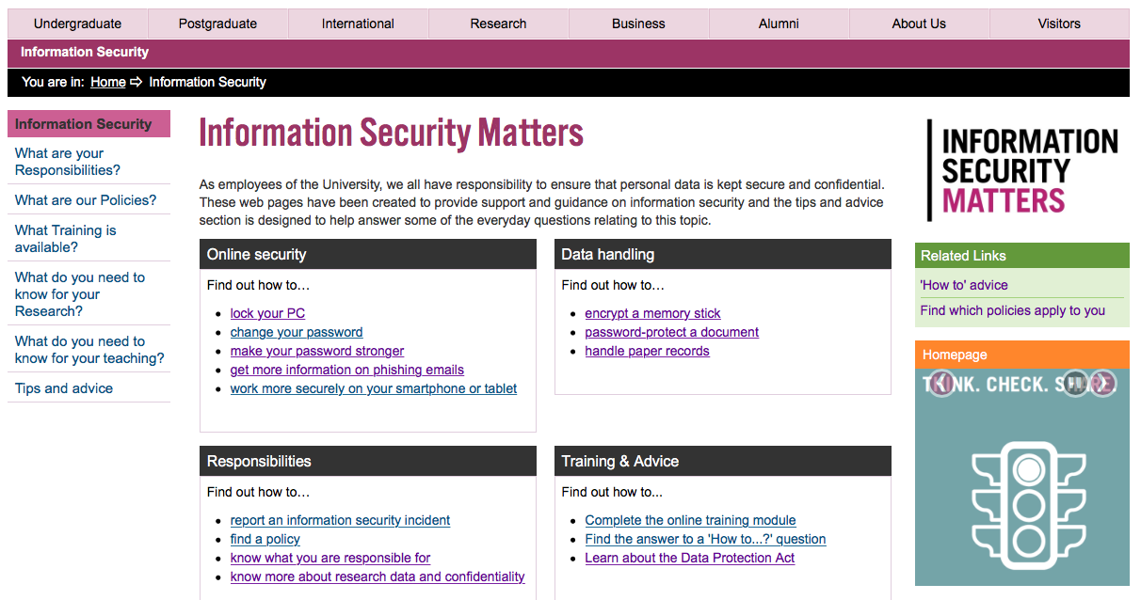
How to share data responsibly
https://www.dur.ac.uk/infosecurity/
Notes:
University Information Security Policies
Data handling and online scurity
Issues: Concentrated omostly on the corporate data not research data collected.

Slide 38
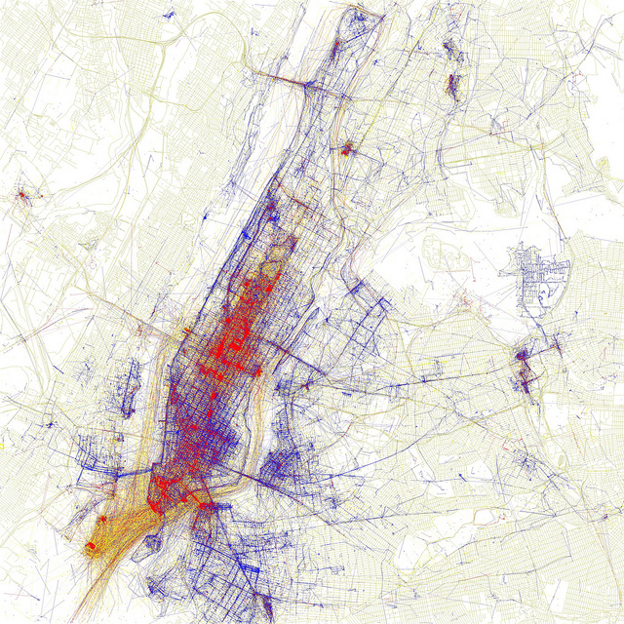
III. Data Management Plans
http://govote.at/fd6c85
Eric Fischer @flickr CC-by-sa
Notes:
https://www.flickr.com/photos/walkingsf/4671594023/in/photostream/
Eric Fischer
Follow
Locals and Tourists #2 (GTWA #1): New York
Blue pictures are by locals. Red pictures are by tourists. Yellow pictures might be by either.
Base map © OpenStreetMap, CC-BY-SA

Slide 39

Data Management Plan
Scope
  - Assessment of existing data
  - Information on new data (i.e. volume, type, format)
Quality assurance of data
  - Principal standards and methodologies
  - Documentation and metadata
  - Backup and security of data (day to day practices)
Expected difficulties in data sharing
  - Collaborative research
  - Ethics and Legal Compliance (confidentiality, consent, DPA)
  - Copyright/intellectual property right
Preparation of data for sharing and archiving
  - Where to deposits data (preservation strategies)
  - When data will be available (embargo)
  - Who will have access (licensing and access governance)
Responsibilities and resourcing
Notes:
DCC. (2013). Checklist for a Data Management Plan. v.4.0. Edinburgh: Digital Curation Centre. Available online: http://www.dcc.ac.uk/resources/data-management-plans
http://www.dcc.ac.uk/sites/default/files/documents/resource/DMP_Checklist_2013.pdf
an explanation of the existing data sources that will be used by the research project with references
an analysis of the gaps identified between the currently available and required data for the research
- information on the data that will be produced by the research project, including:
data volume; data type, eg qualitative or quantitative data; data quality, formats, standards documentation and metadata; methodologies for data collection
- planned quality assurance and back-up procedures [security/storage]
- plans for management and archiving of collected data
- expected difficulties in data sharing, along with and causes and possible measures to overcome these difficulties
- explicit mention of consent, confidentiality, anonymisation and other ethical considerations
- copyright and intellectual property ownership of the data
- responsibilities for data management and curation within research teams at all participating institutions.

Slide 40
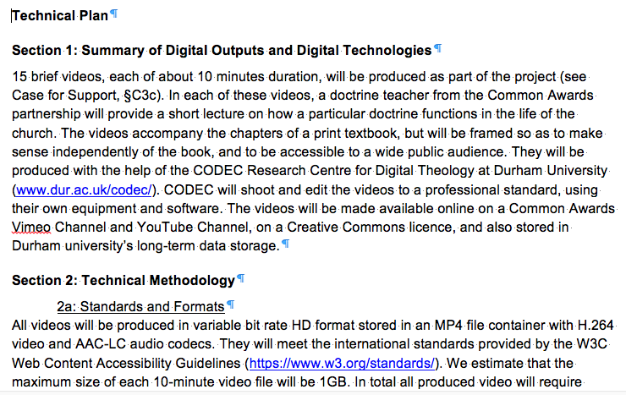
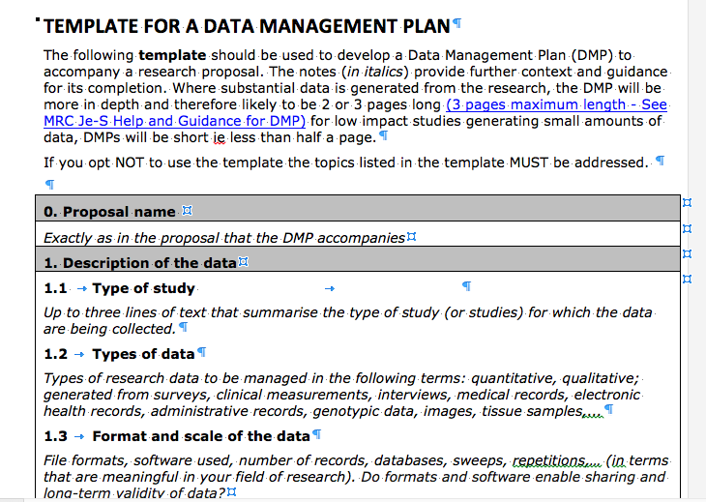
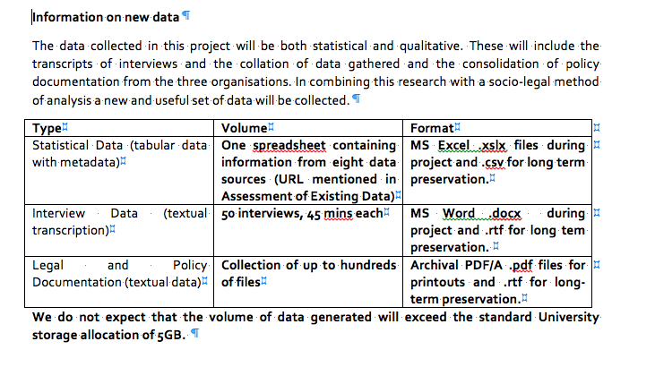
Example Plans
AHRC
ESRC
MRC template

Slide 41
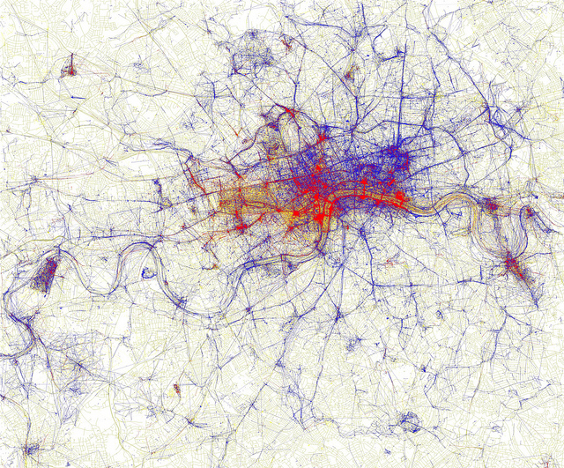
IV. Discussion
http://govote.at/fd6c85
Eric Fischer @flickr CC-by-sa
Notes:
https://www.flickr.com/photos/walkingsf/4671589629/in/photostream/
Eric Fisher @Flickr CC-by-sa
Locals and Tourists #1 (GTWA #2): London
Blue pictures are by locals. Red pictures are by tourists. Yellow pictures might be by either.
Base map © OpenStreetMap, CC-BY-SA

Slide 42
RDM support @ Durham
During the research
After the research
Grant application
Review data management plan
Help estimating data size and types
Advise on costs of storage and preservation
Help documenting data
Help sharing data publicly
Help migrating data to best format
Help licensing OA data
Collaborating over data in controlled environment
1-2-1 training
Check Funders RDM policy
Help with DOIs
Help finding existing data
Deposit data to DRO-DATA
Advice on best practices:
Regular backups
Information security
research.data@durham.ac.uk

Slide 43
RDM Costs Principle
all costs associated with research data management are eligible expenditure of research grant funds, however:
  no expenditure can be ‘double funded’ (a service that is centrally supported by the indirect costs paid on all research grants cannot then also be included as a direct cost on a grant)
  all directly incurred expenditure of a grant must incurred before the end date of the grant.
http://blogs.rcuk.ac.uk/2013/07/09/supporting-research-data-management-costs-through-grant-funding/

Slide 44
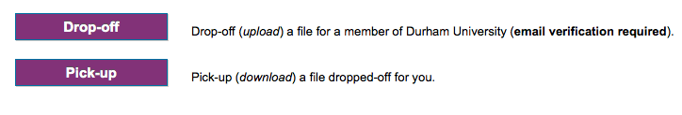
DU storage
Secure file exchange
  http://zendto.dur.ac.uk
New data center
  Josephine Butler and St Mary’s Colleges
  Up to few PB

Slide 45
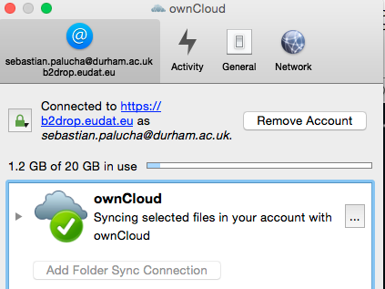
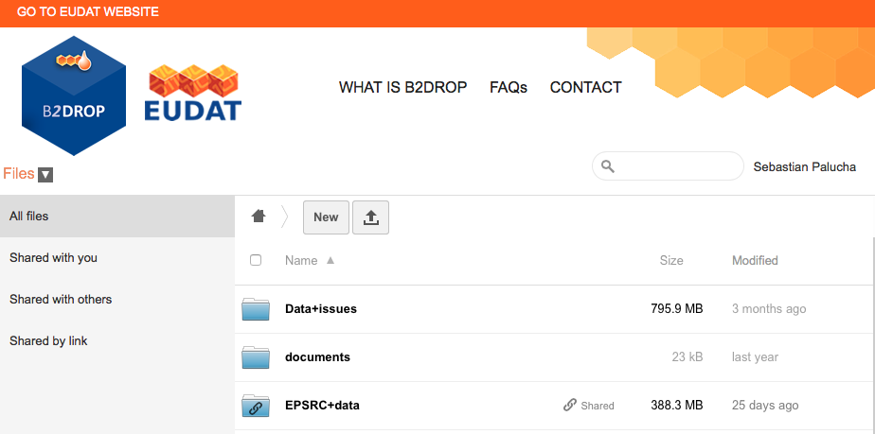
EUDAT cloud storage
Collaborative data infrastructure for EU Research
https://owncloud.org/install/#install-clients
http://b2drop.eudat.eu
Notes:
https://www.dur.ac.uk/cis/security/dropboxcloud/

Slide 46
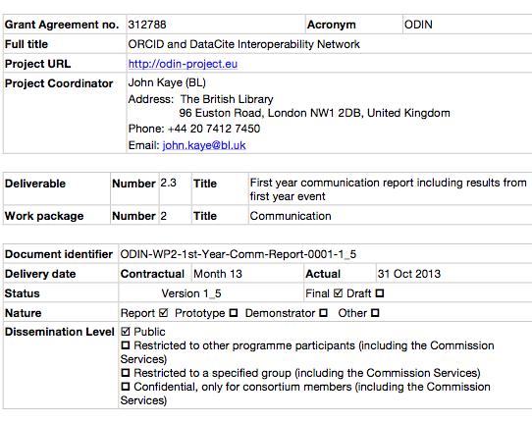
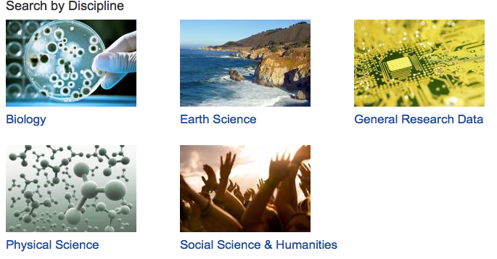
Metadata
Simple
  readme.txt
  cover page
    Advanced,
    domain standards
    - DDI; METS; TEI; QDE
http://www.dcc.ac.uk/resources/metadata-standards
Notes:
Introduce Google search concept – keywords phrase
Important if sharing the data on a repository.
ODIN cover page - http://figshare.com/articles/D2_3_First_year_communication_report_including_results_from_first_year_event/843603
DDI – Data Documentation Initiative
METS - Metadata Encoding and Transmission Standard
TEI – Text Encoding Initiative
QDE – QuDEx – Qualitative Data Exchange from UK Data Archive

Slide 47
Data formats
Think about what format you are saving your data in…
Prefer this… | … over this
ASCII (human readable) (.txt, .xml, .csv ) | Binary formats (.exe, .doc, )
Open standard *.odt *.ods | Proprietary *.docx *.xlsx
Notes:
Examples – Microsoft excel example to use? Older versions?
Microsoft works files in earlier versions of Word.
Comprehensive list of file formats http://en.wikipedia.org/wiki/List_of_file_formats
Example data file formats supported by 3TU Datcentrum - http://datacentrum.3tu.nl/en/what-we-offer/data-archive/#formats
or recommended file formats from UK Data Archivum - http://www.data-archive.ac.uk/create-manage/format/formats

Slide 48
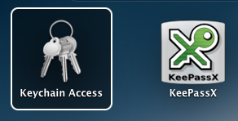

Data security
Passwords
  Do you use passwords >10+
  Password Vault use 128 – 256b
  Public Key Encryption (PKI) 1024b+
  (GPG, GPG4Win, GPGTools)
Virtual Encrypted Drive
  BitLocker, FileVault
https://www.dur.ac.uk/infosecurity/toolkit/
https://www.dur.ac.uk/infosecurity/toolkit/devices/encryption/
Notes:
Practical Tips for strong passwords:
You have to remember we are all human and we all make mistakes - Yh2rwaah&wamm
Strength: 13 characters x 8 bits = 104b
Use one password for one service!
Present keychain
Password generator
Default system password prompt
Windows 7
http://windows.microsoft.com/en-GB/windows7/products/features/bitlocker
MacOS
FileVaoult 2 - http://support.apple.com/en-us/HT4790 – encrypt your entire drive with XTS-AES 128
Olympus
http://uk.pcmag.com/digital-voice-recorders-products/5122/review/olympus-ds-3500
GPG
GPG getting started https://www.gnupg.org/gph/en/manual/c14.html
http://www.data-archive.ac.uk/create-manage/storage/encrypt
https://fedoraproject.org/wiki/Creating_GPG_Keys

Slide 49
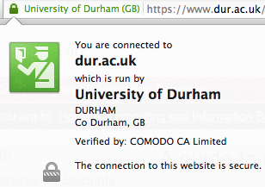
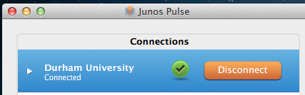
Data security
Secure Interent Protocols
  WiFi: WPA2 but not WEP
  Browser: HTTPS
  Virtual Private Network
  (VPN)
  Secure Shell
  (SSH)
How to access j: drive of campus
  VPN, DU MDS Anywhere
Notes:
https://www.dur.ac.uk/cis/services/remote/
https://www.dur.ac.uk/cis/security/

Slide 50
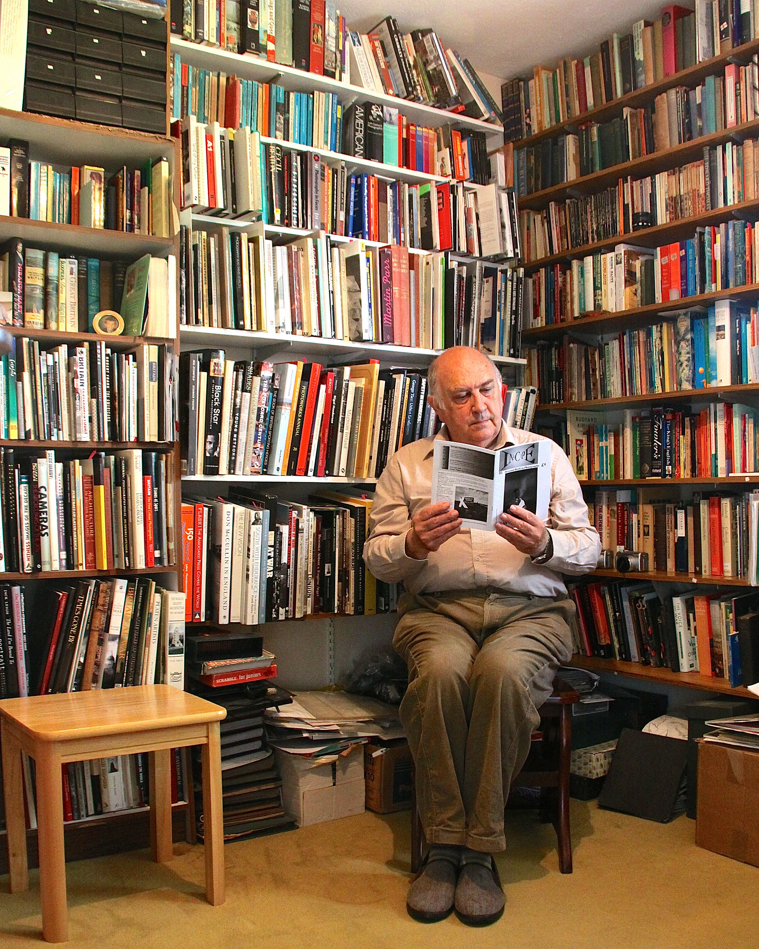

Further Reading
CC by nd George Redgrave @flickr
Notes:
CC by nd https://www.flickr.com/photos/funfilledgeorgie/14428635918
RDM broader concept
Particularly data anonymisation techniques

Slide 51

Inter University Consortium for Political and Social Research
http://www.icpsr.umich.edu/icpsrweb/content/deposit/guide/index.html
Notes:
http://www.icpsr.umich.edu/icpsrweb/content/deposit/guide/index.html

Slide 52

Managing And Sharing Research Data – A Guide to Good Practice
https://www.ukdataservice.ac.uk/manage-data/handbook

Slide 53

https://www.dataone.org/news/data-management-guide-citizen-scientists-released
Notes:
Data Management Guide for Citizen Scientists released
The guide provides a step-by-step introduction to the data management lifecycle. It includes examples from citizen science projects and links to best practices and tools to help project organizers optimize the quality, usability and accessibility of their project data. Better data management makes data easier to find, use, analyse, share and reuse, and this guide helps explain the processes involved in data management.

Slide 54

Spreadsheet Help
http://cdluc3.github.io/spreadsheet-help/

Slide 55

Anonymisation Decision-Making Framework book, 2016, CC by nd
http://ukanon.net/ukan-resources/ukan-decision-making-framework/
Notes:
Written by members of UK Anonymisation Network UKAN,
An 1h free anonymisation clinic 1-2-1 session is offered, http://ukanon.net/services-for-members/

Slide 56

http://www.nature.com/collections/qghhqm

Slide 57

Scientists need to be more open among themselves and with the public and media
Greater recognition needs to be given to the value of data gathering, analysis and communication
Common standards for sharing information are required to make it widely usable
Publishing data in a reusable form to support findings must be mandatory
More experts in managing and supporting the use of digital data are required
New software tools need to be developed to analyse the growing amount of data being gathered
Notes:
Cover image: The Spanish Cucumber E. Coli. In May 2011, there was an outbreak of a unusual Shiga-Toxin producing strain of E.Coli, beginning in Hamburg in Germany. This has been dubbed the ‘Spanish cucumber’ outbreak because the bacteria were initially thought to have come from cucumbers produced in Spain. … this genome was analysed within weeks because of a global and open effort; data about the strain’s genome sequence were released freely over the internet as soon as they were produced.

Slide 58

Open Science
“With the right formats, licensing and distribution mechanisms, people can easily collaborate over data, enhance the analysis and re-purpose for their own needs.” Cameron Neylon
http://cameronneylon.net/blog/fork-merge-and-crowd-sourcing-data-curation/
Notes:
Open Data foster Open Science
Ten Simple Rules for the Care and Feeding of Scientific Data - http://journals.plos.org/ploscompbiol/article?id=10.1371/journal.pcbi.1003542
Rule 1. Love Your Data, and Help Others Love It, Too
Rule 2. Share Your Data Online, with a Permanent Identifier
Rule 3. Conduct Science with a Particular Level of Reuse in Mind
Rule 4. Publish Workflow as Context
Rule 5. Link Your Data to Your Publications as Often as Possible
Rule 6. Publish Your Code (Even the Small Bits)
Rule 7. State How You Want to Get Credit
Rule 8. Foster and Use Data Repositories
Rule 9. Reward Colleagues Who Share Their Data Properly
Rule 10. Be a Booster for Data Science

